Slide 1

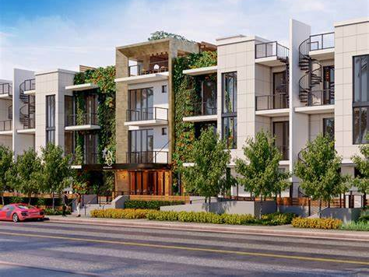
Smart office networking system

Slide 2





Group Members CSEC 399 (A)
2.
Tonima akter ID:2191081017
Batch:47(A)
3.
Israt jahan sathi ID:2192081027
Batch:48(A)
4.
Amit hasan ID:2192081017
Batch:48(A)
Supervisor: Ratul Sikder
1.
Nusrat jahan bithi ID:2192081026
Batch:48(A)

Slide 3
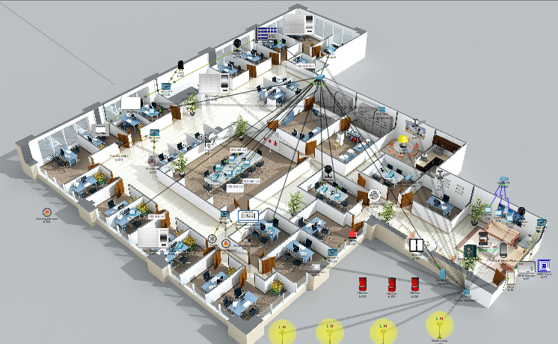
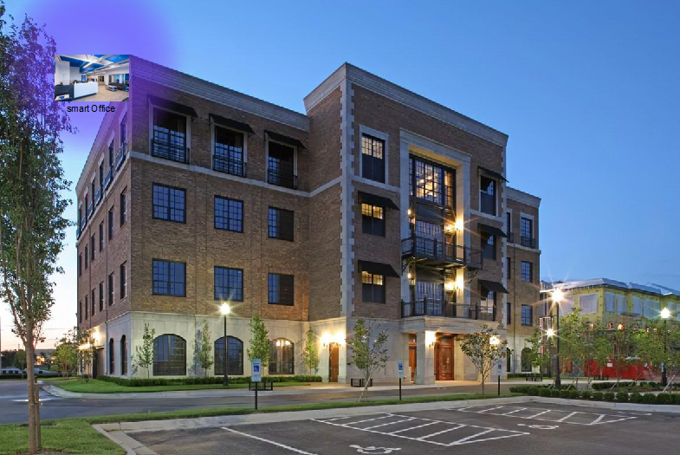
Video slide
Project design:
Smart Office
3

Slide 4
Agenda
Introduction
01
Background Study
02
Project Methodology
03
Possible Outcome
04
Expected Outcome.
05
Conclusion
06
4

Slide 5






Introduction
IOT
“things”—that are embedded with sensors, software, and other technologies for the purpose of connecting and exchanging data with other devices and systems over the internet.
Network Sequrity
Is a type which secure the data .
Smart Office
A smart office is a workplace where modern technology is leveraged to help employees work smarter, better, and faster
Computer Networking
Computer networking refers to connected computing devices and an ever-expanding array of IoT devices and pc that communication with one another.
LAN
Local Area Network is a collection of devices connection together in one physical location
5

Slide 6
Objectives:
Part 1: Add Home Gateway to the Network.
Part 2: Connect IoT Devices to the Wireless Network.
Part 3: Sequrity System.
Part 4: Add End User Device to the Network.
6

Slide 7



Background Study
01
02
03
High Voltage Pvt.Ltd
Smart office include fingerprint regognation,smart light,Fire Alert etc.
Dhaka Stock Exchange
They have strict sequrity system. Fingerprint ,smart id card are the one of the option to verified the person
INTEL SRR3
SRR3, the 628,000-square-foot, nine-story office building is 48 percent more energy efficient than other like buildings, produces 70potential to save over 12 million gallons (MGY) of potable water annuallypercent less greenhouseGHG) emissions and has the potential to save over 12 million gallons (MGY) of potable water annually.

Slide 8
Model Selection
As a Project team we will choose SDLC Model
1. The task can be frequently
changes are required on
clientdemand .
Anytime changes are acceptable.
3. Time limit 12 months
Requrement Analysis
Final Review
01
07
logical and physical model
Implementation design
02
SDLC models
06
reviewing the overall documents
03
Coding and testing
improving
05
04
Completion of checking reviewing the overall documents
Full designing

Slide 9

PROJECT TIMELINES – GANTT CHART
MAY | JUN | JULY | AUG | SEP | OCT | NOV | DEC | JAN | FEB | MAR | APR
coding
Completion of publishing the document template
Tasks 8
Tasks 3
Tasks 6
Testing and improving.
Tasks 10
Tasks 2
Tasks 5
logical and physical model implementation
Process layout design
Tasks 4
Tasks 9
Full designing
Tasks 7
Completion of checking and reviewing the overall documents
Tasks 1
.
prepare proposal & presentation
.
Selecting Idea.
Investigation of problem
And meeting analysis of problem
8

Slide 10
Step-1(Configuring Router1):
1. Select the router and Open CLI.
2. Press ENTER to start configuring Router1.
3. Type enable to activate the privileged mode.
4. Type config t(configure terminal) to access the configuration menu.
5. Configure interfaces of Router1
Step-2 (Configuring PCs):
1. Assign IP Addresses to every PC in the network.
2. Select the PC, Go to the desktop and select IP
Configuration and assign an IP address, Default
gateway, Subnet Mask
3. Assign the default gateway of PC0 as 192.168.10.1.
4. Assign the default gateway of PC1 as 192.168.20.1.
5. Connect FastEthernet0 port of PC0 with FastEthernet0/0 port of Router1 using a
copper straight-through cable.

Slide 11
Router1 Command Line Interface:
Router>enable
Router#config t
Enter configuration commands, one per line. End with CNTL/Z.
Router(config)#interface FastEthernet0/0
Router(config-if)#ip address 192.168.10.1 255.255.255.0
Router(config-if)#no shutdown

Slide 12
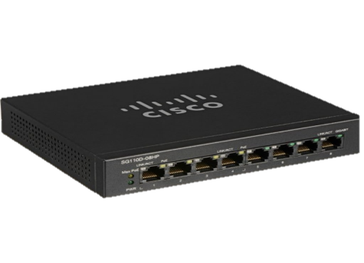


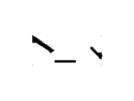
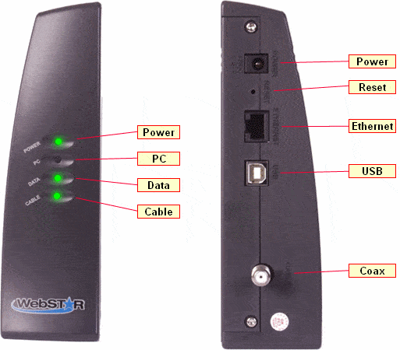

Router
IP address:192.168.1.8
Submusk:255.255.255.0
Switch
IP address:192.168.0.6
Submusk:255.255.255.0
IP address:192.168.0.1
Submusk:255.255.255.0
IP address:192.168.0.4
Submusk:255.255.255.0
IP address:192.168.0.5
Submusk:255.255.255.0
IP address:192.168.0.2
Submusk:255.255.255.0
IP address:192.168.0.3
Submusk:255.255.255.0
Laptop

Slide 13
IP Phone is the most creative thing in computer networks. Internet protocol phones allow us to make calls over IP address. IP Phones use Voice-over IP technology.
STEP 1: Start your Cisco packet tracer and drag & drop two IP Phones, one Switch, and one Router. connect both IP Phones to switch and Switch to Router. STEP 2: Now start IP Phone by enabling power cables.
STEP 3: Configuration of Router 1. Go to the router and enable then go to global configuration mode. 2. Change the Hostname of Router router(config)#hostname Everdata 3. Give the IP address Everdata(config)#interface fa0/0 //where switch is connected Everdata(config-if)#ip address 192.168.10.1 255.255.255.0 #exit
STEP 4: DHCP configuration on the router 1. Go to the router's global configuration mode and create a DHCP pool Everdata(config)# ip DHCP pool IPPHONE Everdata(config)# network 192.168.10.0 255.255.255.0 #default-router 192.168.10.1 #option 150 ip 192.168.10.1
STEP 5: Configuration of TAGS for calling For IPPHONE 1 Everdata(config)#ephone-dn 1 Everdata(config-ephone-dn)# number 0001 For IPPHONE 2 Everdata(config)#ephone-dn 2 Everdata(config-ephone-dn)#number 0002 STEP 6: Switch configuration for IPPHONE Switch(config)#interface range fa0/1-24 Switch(config-if-range)#switchport mode access #switchport voice vlan 1
STEP 8: Now just wait for IPPHONE to get tags names and number and go to IPPHONE to checking. ring on 0002 from IPPHONE 0001. it will start calling as well as give you after taking a call -connected.

Slide 14
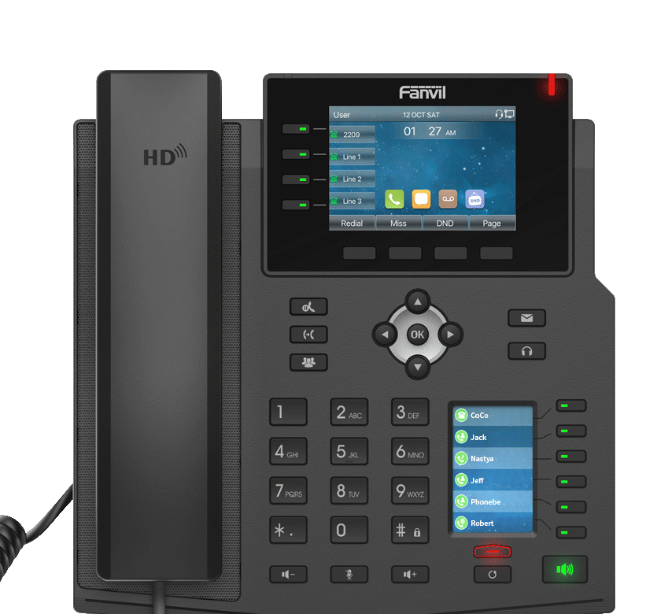
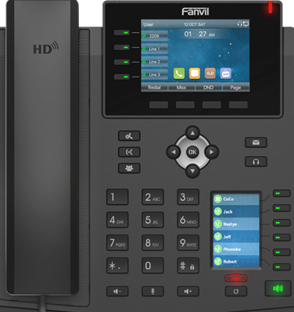

01772199294
Nusrat
Ring out …………….

Slide 15
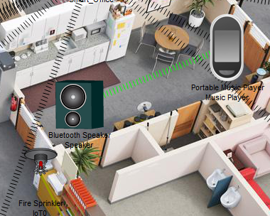
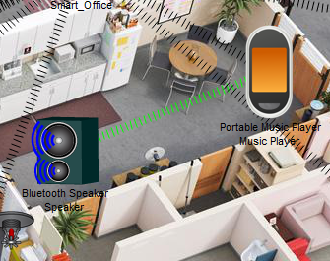
Music Player
Music player: Music can be played using music player via Bluetooth on a portable speaker. Entertainment purpose.
Music player
Music player
8

Slide 16
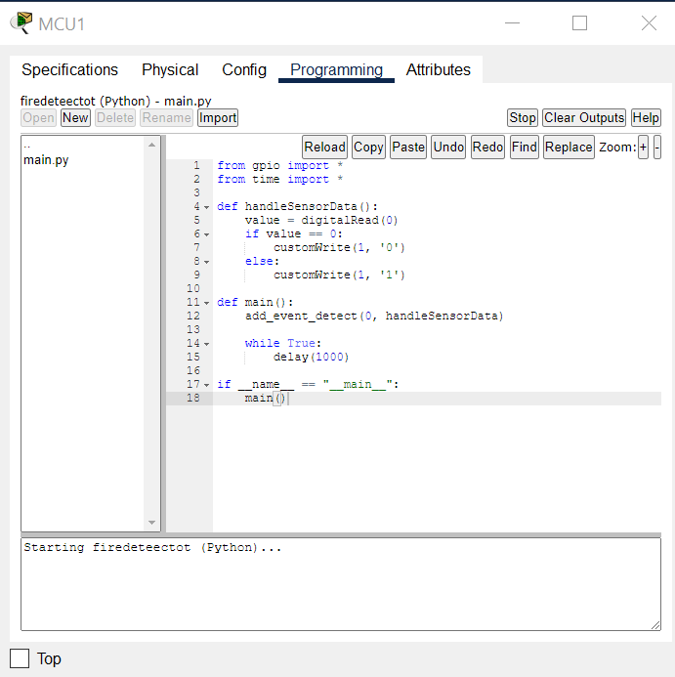
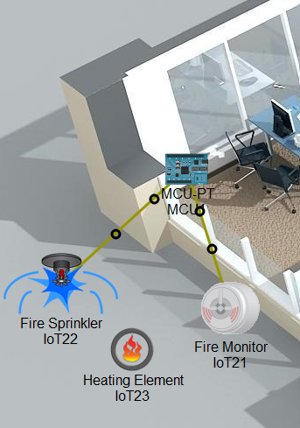
Fire alarm & smoke alarm
Fire alarm & smoke alarm:
1. If anything catches fire, the fire detector will give siren to alert everyone.
If ridiculous amount of smoke is generated by vehicle, smoke detector will siren alert.
Even though programming language support was provided by the cisco
packet tracer, the researcher used Java Script and Python for
implementation.
Fire alarm & smoke alarm

Slide 17
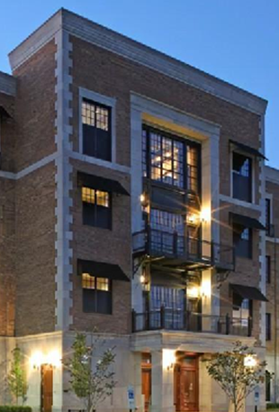
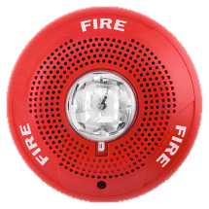





Slide 18




Expected outcome
Improve Employess Satisfaction
Fire Alert,Time saving 3
Power Saving 1
Smart Rfid 4
18

Slide 19
Possible Outcome:
When the smart office are at their best when
their lives will be the best too.
However, in order to make your office smart,
the application of IoT is necessary as it helps the
owner to control and supervise their lights, ac,
fans, windrow ,door lock,webcam security and
other office devices through any of their
smartphone devices.
In short, a smart office is a modern
technological experience that will help the
owners save their money,
time, and energy spent on their daily-life.
19

Slide 20
conclusion:
IoT is the new trendsetter in today’s world due to its amazing and advanced applications which
makes life easier for both individuals and entrepreneurs.
With such demand, the scope of IoT in the upcoming days will also be more as there will be
more smart homes , smart office, retails, and cities.
3. Each application of IoT will be in great use and the demand will be more as well IoT along with
AI will also be advanced as new scopes, markets and all of this will lead to a better economy
and a fast-evolving lifestyle.
20

Slide 21



